Slide 1
Pound–Drever–Hall laser frequency stabilization
Developing an integrated Laser Frequency Stabilization System

Slide 2
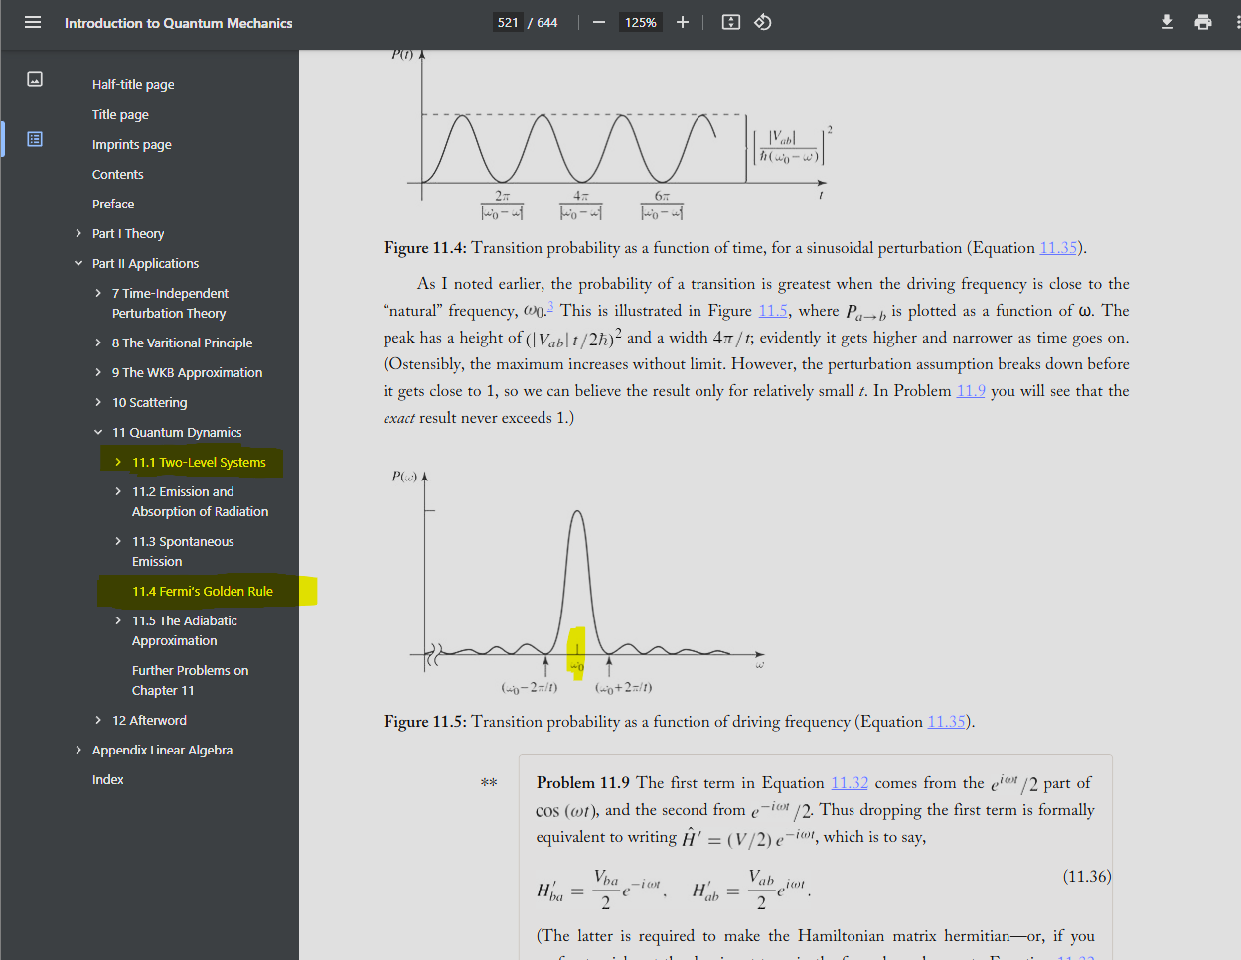
Why do I bother to lock a laser?
Any system that requires an exact band gap to have some transitions demand this technique

Slide 3
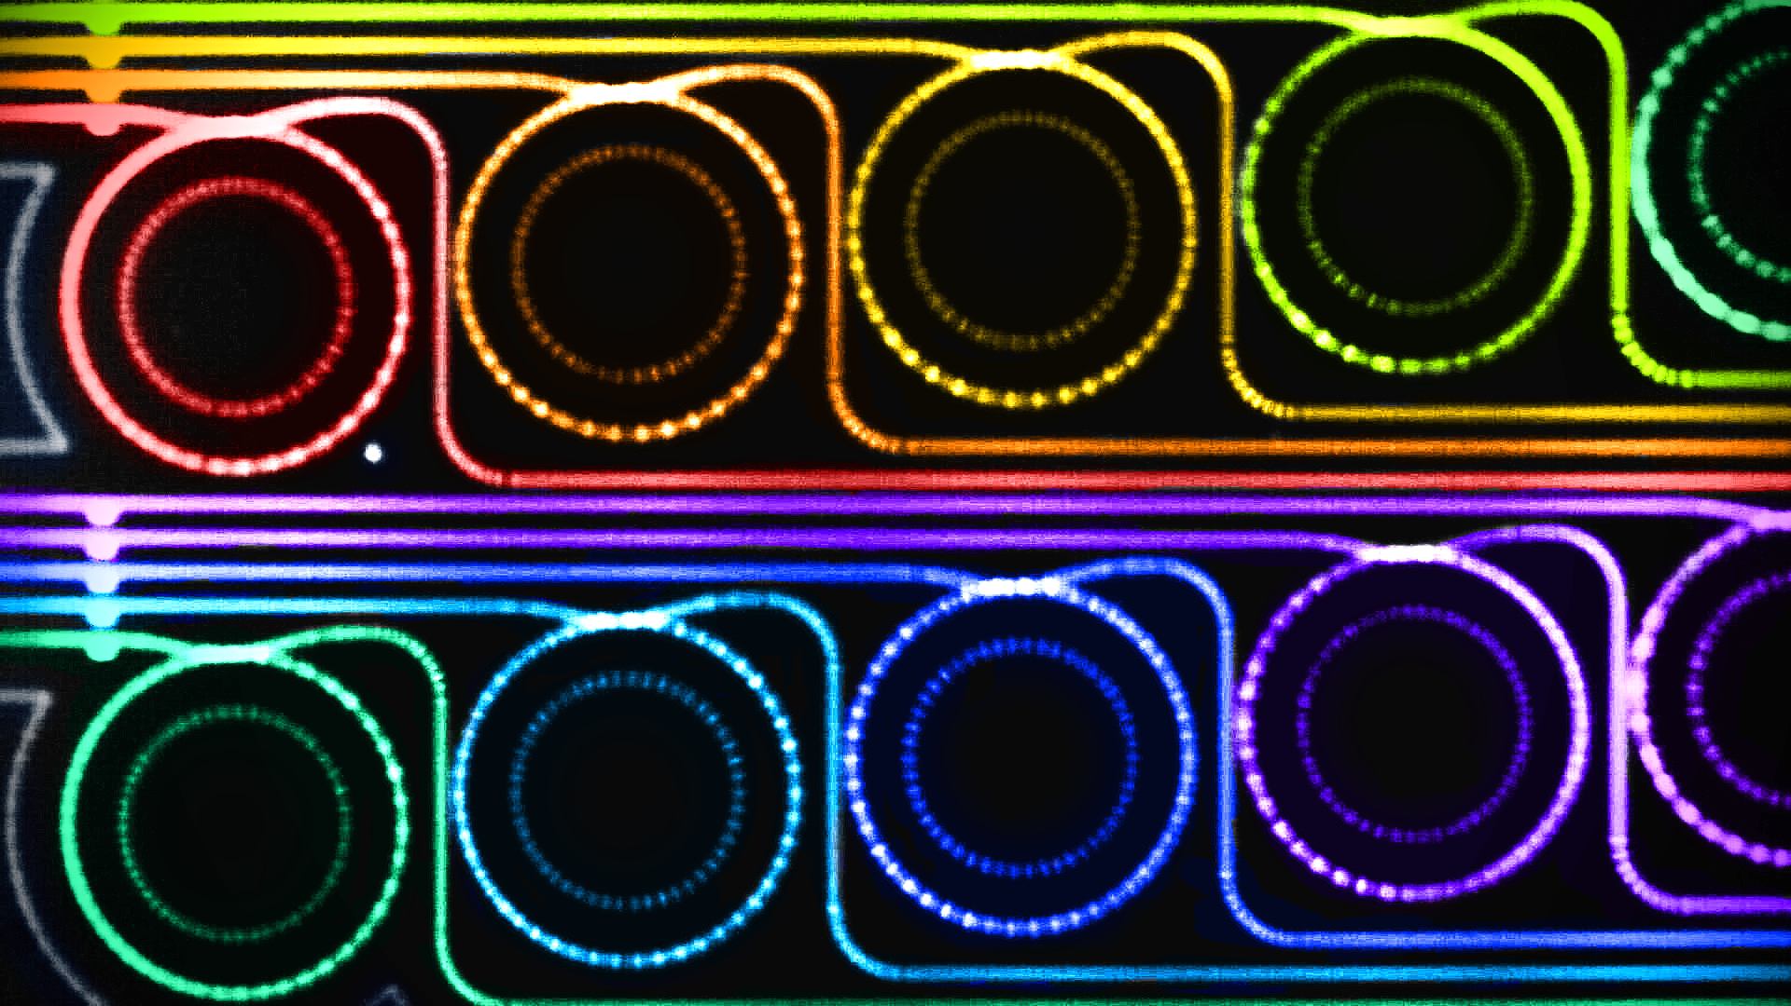
Why is it interesting
whispering gallery mode
Applicable to any system that has a sensitive response to frequency
Gravitational wave detector
Cavity Quantum Electrodynamics
Atomic Physics
Any system that requires an exact band gap to have some transitions demand this technique

Slide 4
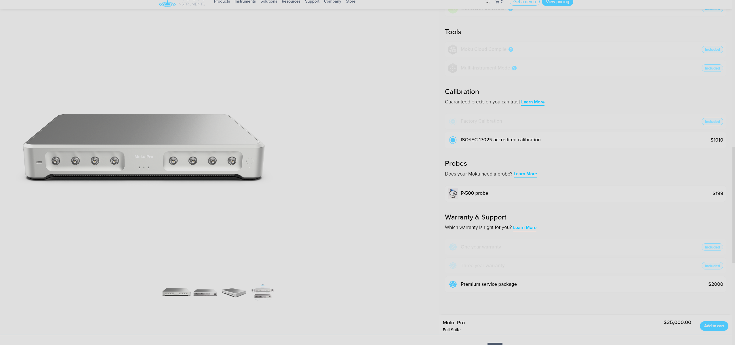

Doesn’t it already exist commercially?
Yes, but the price is notoriously expensive.
A great laser lock box plus a good single-mode laser almost goes up to a nice Porsche.

Slide 5
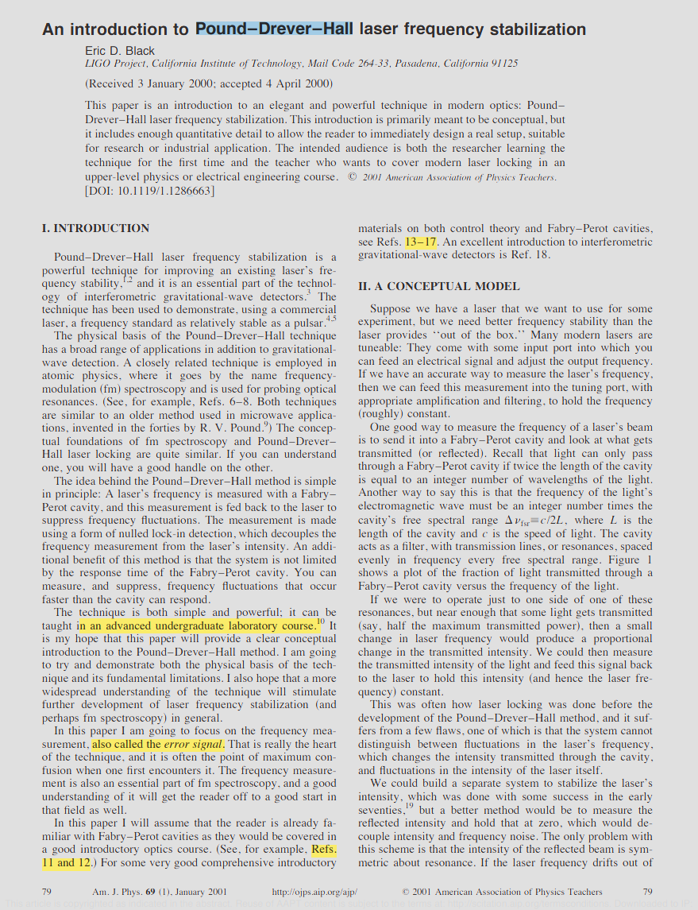
What is the basic physics involved?
It involves E&M(very basic EM, AP level)
Control theory---Pound–Drever–Hall
Laser locking is crucial to researcher in quantum cavity system and atomic physics
In fact, you will see a great degree of similarity between this technique and quantum mechanics, at least in the mathematical structure

Slide 6
A little bit about theory
https://drive.google.com/file/d/1yRLVk08-PLvTKxMGwYdIlNJY4dncPQnD/view?usp=sharing

Slide 7
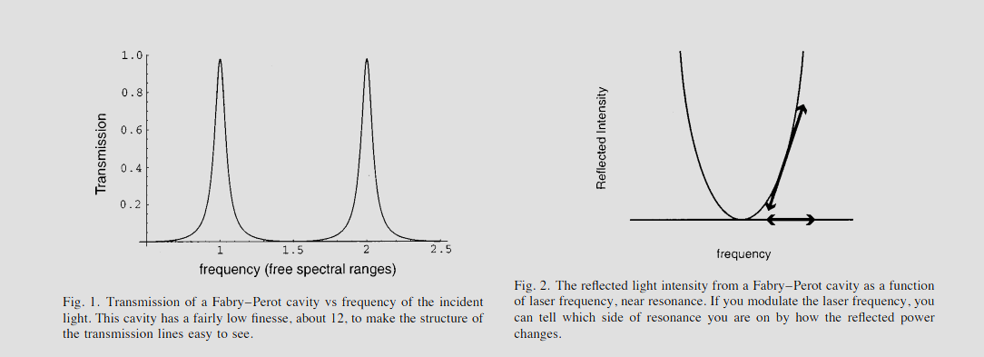
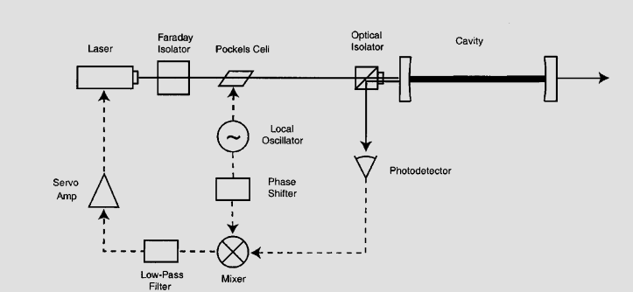
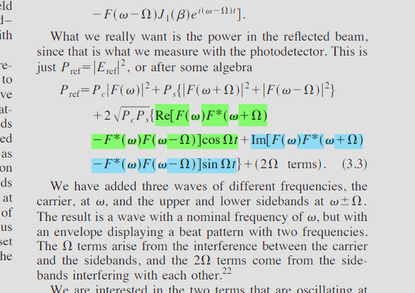
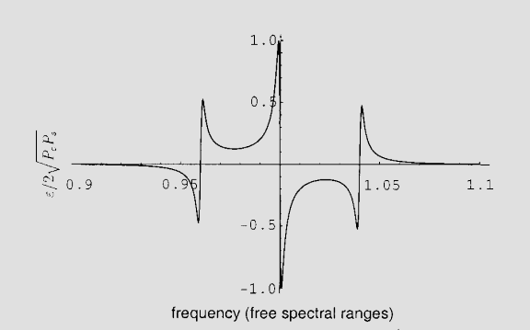
What do I need to do?
Generate a resonance signal
Demodulate it into the error signal that I am looking for(This need to be done on PCB, all be integrated)
Apply PID on this signal(a tons of open source PID on github)
Output the voltage signal(or it could be current) to lock the laser

Slide 8
What do you hope to learn or demonstrate?
My goal is at the end of the quarter:
I will hand you with my integrated device
Plug it in to a laser
The laser continuously locks at the frequency you want for hours

Slide 9
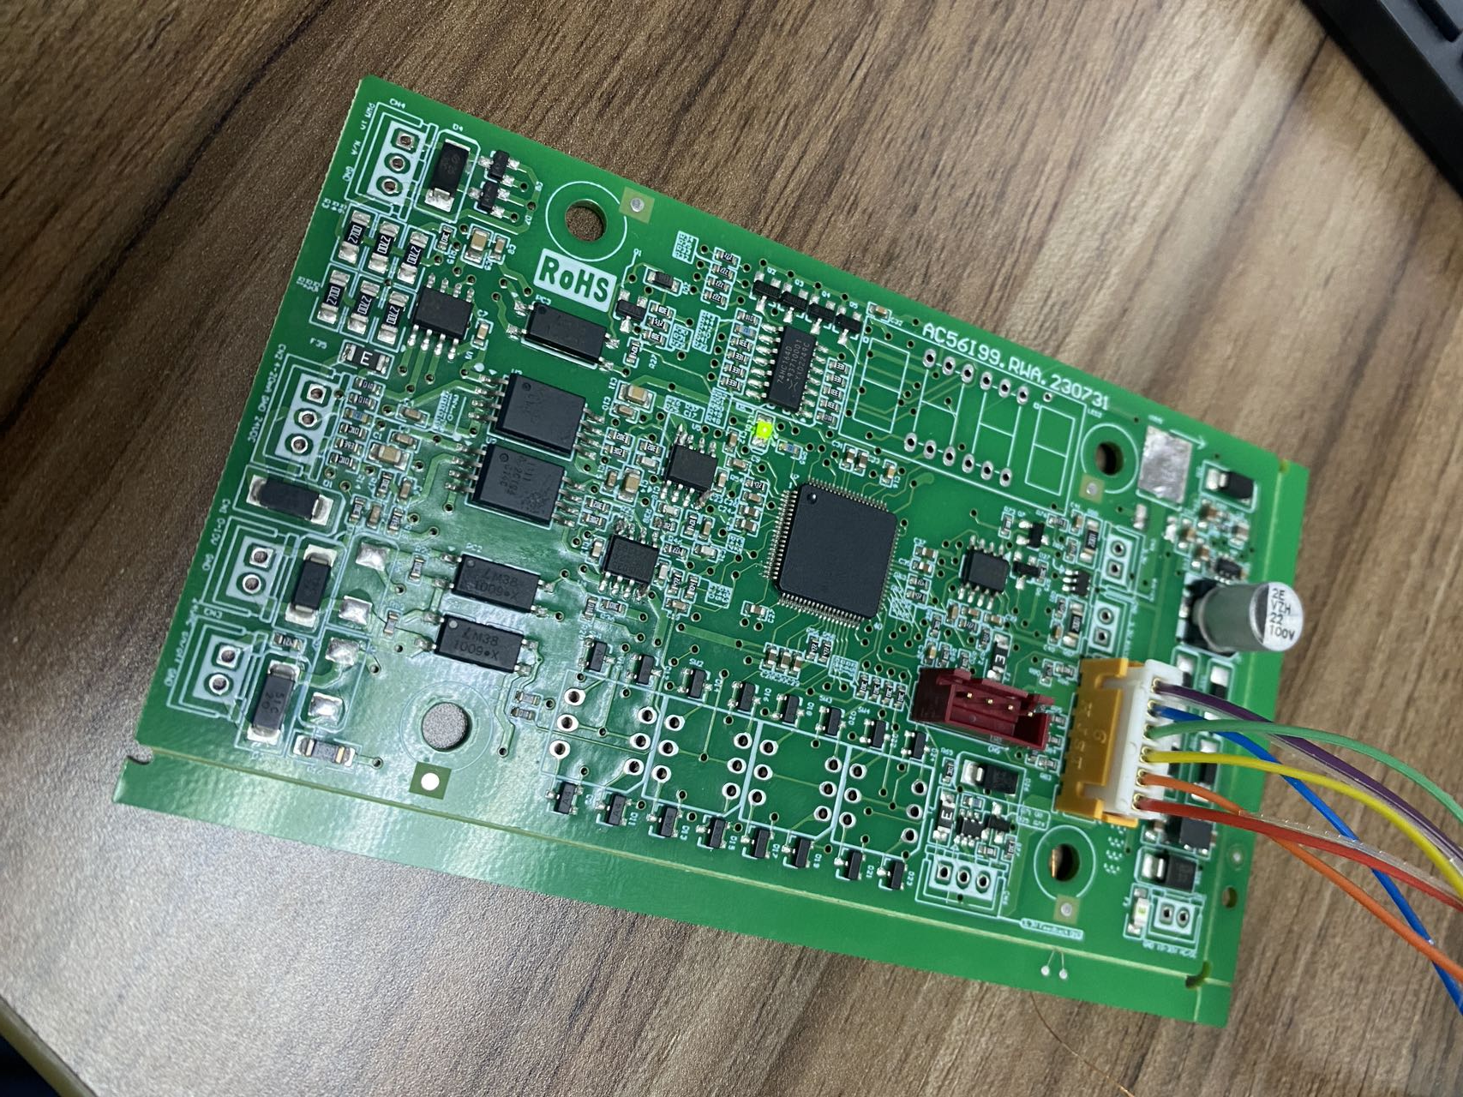
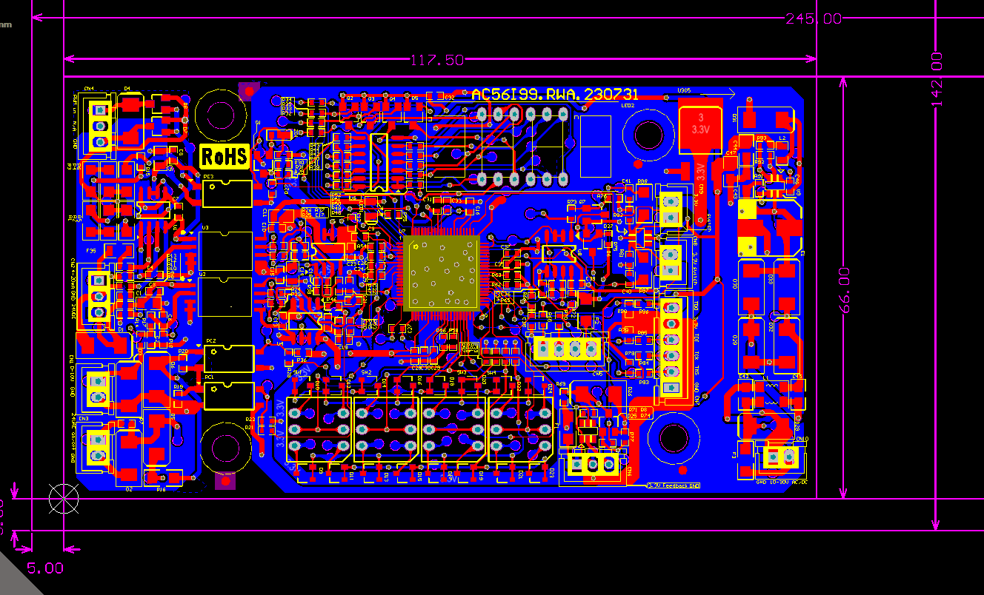
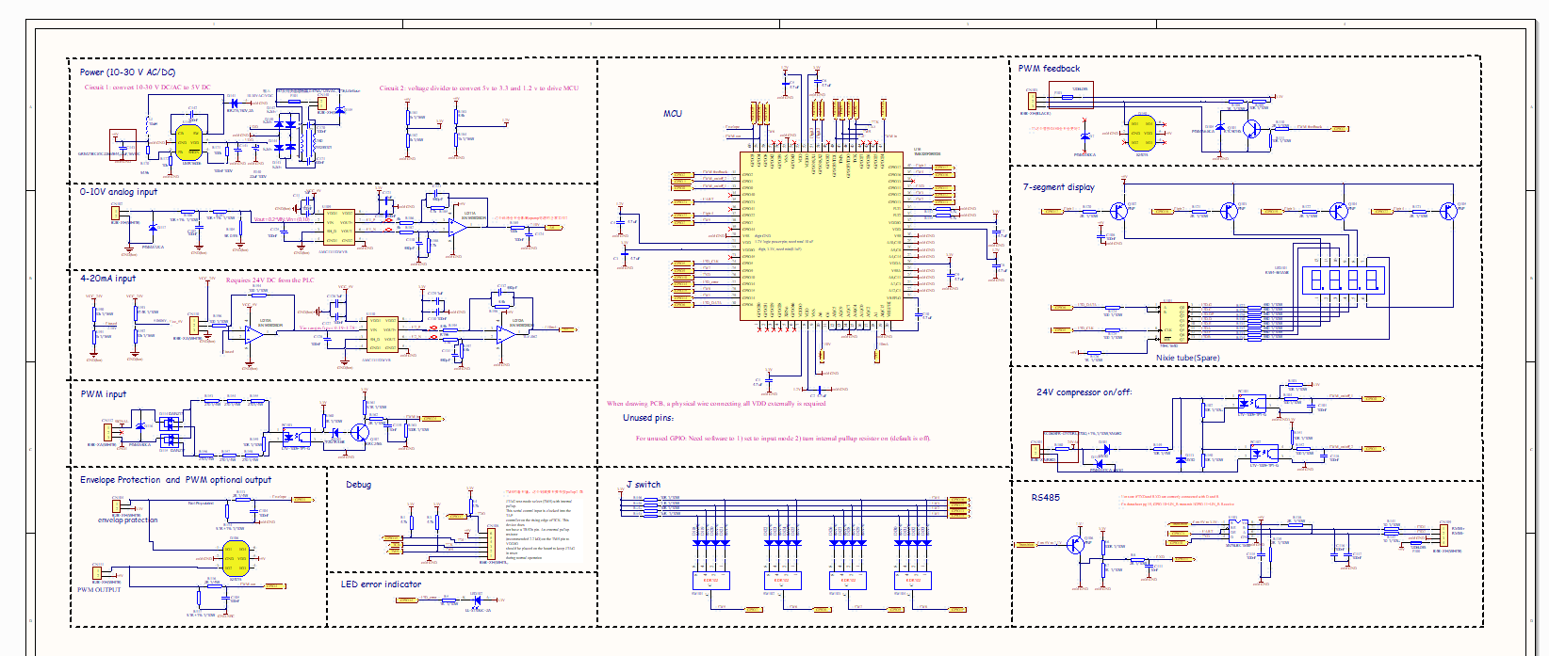
Is this doable in 10 weeks and 450 dollars?
Yes.
In fact, the paper I showed about cavity locking is from one of the experiments in Caltech’s senior lab course.
Caltech students do three such experiments in a quarter, so I don’t think there is any reason we cannot refine one experiment into an integrated platform, given a whole quarter.

